Slide 1
4. Structure of Java Program
Presented by S.R.Zameer

Slide 2
Structure of Java Program
Structure of a java program is the standard format released by Language developer to the Industry programmer.
Sun Micro System has prescribed the following structure for the java programmers for developing java application.

Slide 3
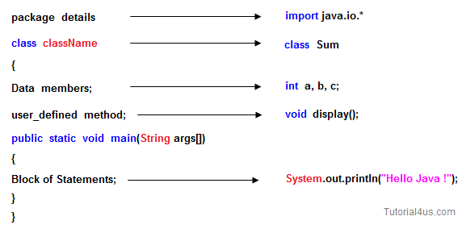
Structure of Java Program

Slide 4
Package
A package is a collection of classes, interfaces and sub-packages. A sub package contains collection of classes, interfaces and sub-sub packages etc. java.lang.*; package is imported by default and this package is known as default package.

Slide 5
Class
Class is keyword used for developing user defined data type and every java program must start with a concept of class.
"ClassName" represent a java valid variable name treated as a name of the class each and every class name in java is treated as user-defined data type.

Slide 6
Data member
Data member represents either instance or static they will be selected based on the name of the class.

Slide 7
User-defined methods
User-defined methods represents either instance or static they are meant for performing the operations either once or each and every time.

Slide 8
Main() Method
main() method is starting execution block of a java program or any java program start their execution from main method. If any class contain main() method known as main class.

Slide 9
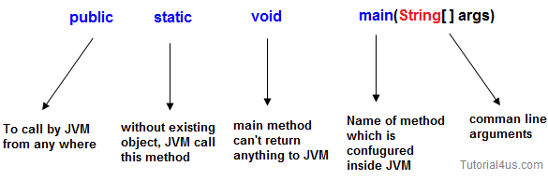
Syntax of main() method:
public static void main(String args[])
{
....... .......
}

Slide 10
Public
public is a keyword in a java language whenever if it is preceded by main() method the scope is available anywhere in the java environment that means main() method can be executed from anywhere. main() method must be accessed by every java programmer and hence whose access specifier must be public.

Slide 11
Static
static is a keyword in java if it is preceded by any class properties for that memory is allocated only once in the program. Static method are executed only once in the program. main() method of java executes only once throughout the java program execution and hence it declare must be static.

Slide 12
Void
void is a special datatype also known as no return type, whenever it is preceded by main() method that will be never return any value to the operating system. main() method of java is not returning any value and hence its return type must be void.

Slide 13
String args[]
String args[] is a String array used to hold command line arguments in the form of String values.

Slide 14
Block of statements
Block of statements represents set of executable statements which are in term calling user-defined methods are containing business-logic.
The file naming conversion in the java programming is that which-ever class is containing main() method, that class name must be given as a file name with an extension .java.

